Slide 1
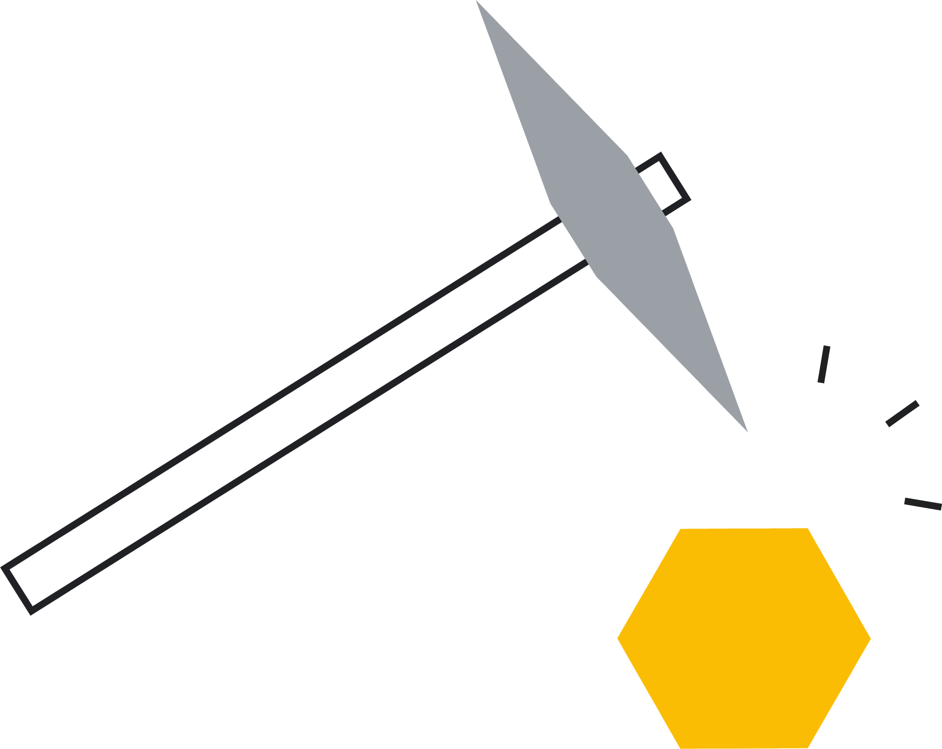
4. Design the test
Notes:
Teacher notes
This session demonstrates the different approaches taken in the design phase.
It encourages students to think about every aspect of their design to ensure it is robust.
Students are challenged to continually alter and refine their design based on results generated, until they have reached an optimum.
If students have not developed a clear idea of their solution, please use session 3.
This is the fourth of six sessions that work through the problem-solving process. They have been designed to form a basis for a one-hour session, but they can be used flexibly and adapted to suit the needs of your class. The seventh lesson provides further information on entering Google Science Fair.

Slide 2

1
2
3
5
6
7
Identify a problem
Generate ideas
Develop a solution
Design the test
Communicate the results
Draw conclusions
Enter the competition

Slide 3
Session 4: Outline
Ways to test Case studies Activity 1: Cubing Methods Refine your design Activity 2: SCAMPER Generate your results
5 mins 10 mins 25 mins 5 mins Unlimited 15 mins Unlimited
05 06 07 09 13 14 23

Slide 4

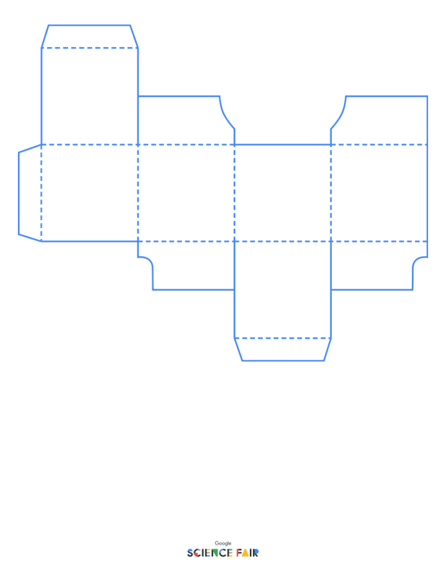
Materials you’ll need
A key question that clearly summarizes the problem you are going to solve A developed solution to your problem Writing supplies Scissors & tape/glue Materials for prototyping/experimenting Activity 1: Cubing Activity 2: SCAMPER

Slide 5
Prototype
Experiment
Analyze
Can you build a physical model of your solution?
It might be a working model.
It might be a proof of concept — a way to visualize the solution using any materials.
What will you test?
Is there an experiment you can conduct that supports your solution?
What results are you aiming towards?
So, you need to dig deeper and examine your solution?
Collect and analyze data.
What trends are you looking to find?
You will need to show how the prototype can be used to give results to backup your solution.
You will need to show how the experiment can be used to give results to backup your solution.
You will need to show how your project can be used to give results to backup your solution.
Notes:
Teacher notes
Encourage students to think broadly about what they are designing. The route they choose will depend on the type of solution they have come up with.
Prototype: this does not necessarily need to be a fully working model - although great if it is. It could be made of everyday materials and simply be a way to better visualize how the solution will work (a proof of concept).
Experiment: students can conduct an appropriate experiment that links to their solution.
Analyze: students may find there is no physical or making element to their solution but instead further thinking/research/analysis. Ensure that students are aware this must yield a set of results that support their solution.
All tests must comply with school/lab health and safety regulations and the Google Science Fair rules.

Slide 6
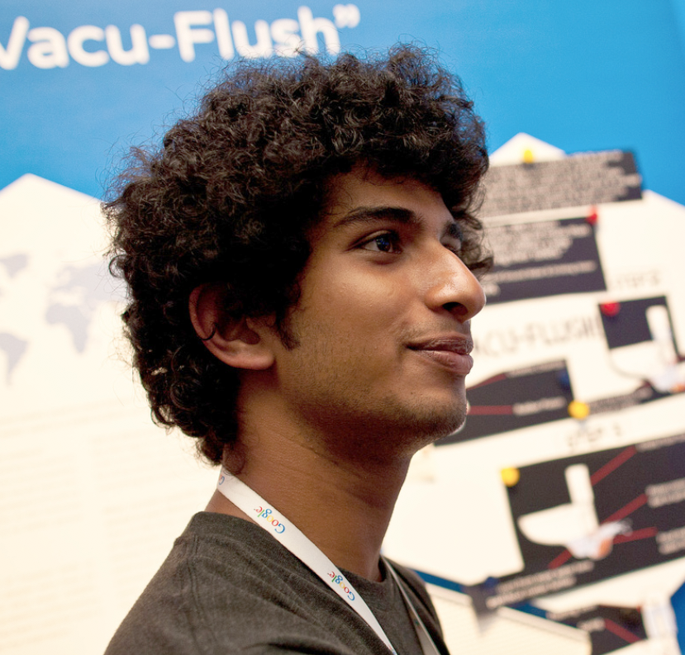
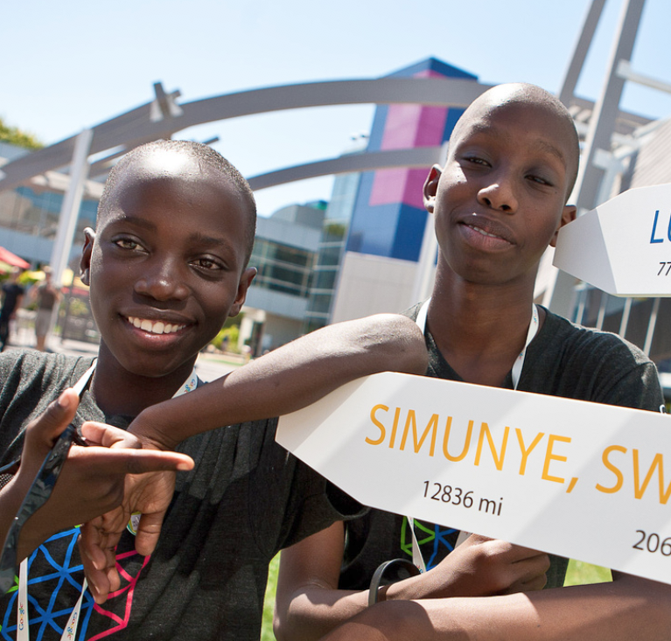
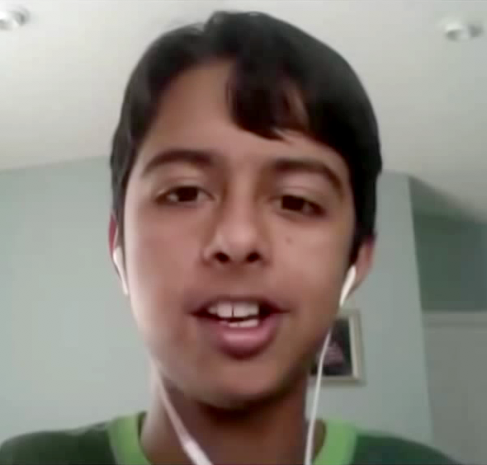
Prototype
Experiment
Analyze
E.g. Rohit Fenn created a proof of concept for a more environmentally-friendly toilet flush.
E.g. Sakhiwe and Bonkhe looked into a new type of hydroponics for subsistence farmers.
E.g. Venkat Sankur examined data on endangered species and tested his predictions with computer modelling.
Notes:
Teacher notes
Share clips of previous winners with the class, showcasing the different methods that have been used to gather results.
Reassure students they can do this - the idea is not to come up with something than can immediately be manufactured and put to use - it is the thought process behind the idea, and the potential impact that Google Science Fair looks for.
Emphasize the importance of yielding meaningful results.
Remind them that all tests need to provide results.

Slide 7
Activity 1: Cubing
Cubing
Materials What will you need? What is available? Where will you source things from? Method How will you do this? Can you write step-by-step instructions or a flowchart giving directions? Expertise Are there finer details that require people with a different skill set? Do you need to do any consumer research?
Timings Are you keeping to your timeline? Do you need to build in buffer time? Testing Are you getting the results you expected? Are you testing within an appropriate range?
Argue for and against Pick one of the areas and reflect and refine it.
Notes:
Teacher notes
Hand out Activity 1: Cubing and allow students time to cut and build the cube.
Have the definitions up so students can read these while they build.
Ask students to roll the cube and begin the design process depending on the section they land on. By the end students should have completed all areas, thus building a robust design brief.
Introduce the importance of refining and the iterative design process: this design is not set in stone and should be open to change.
The more students work on the design, the more they should see it evolve and improve.

Slide 8
Refining
Materials What other materials could you use? Are there cheaper alternatives? Could a recycled material be used? Method Give the method to someone else — are they able to follow it? What comments do they have? Write an alternative method and compare it. Expertise Whose help will you need? Who will you need to contact? How will you do this?
Timings Get a timeline together. What are your key milestones? When do you ideally want results by? Is this realistic? Testing What are you testing? What results are you aiming for? How can you ensure your testing is reliable?
Argue for and against Pick one of the areas and reflect and refine it.
Notes:
Teacher notes
Explain to students that the ‘Argue for and against’ side enables them to constantly question and refine their idea.
Students should continue to apply this throughout the design process.
At this point, give students free reign to take the design in the direction they wish. Support them however you can with collecting data, connecting with the right industry experts, sourcing materials etc.
Importantly, facilitate but do not take over - ensure students continue to lead their own designs.

Slide 9

Which method does your solution follow?
Select the most appropriate method for you to test your solution:
Engineering
Scientific
Computational
Notes:
Teacher notes
Allow students time to think about the methods and choose one to apply to their test.
Depending on your students and their solutions, you could choose to focus on one method, or discuss all of them.
Ensure students are thinking about what results they will generate and how they can use this data to support their solution.
If students get stuck with something that is not working, encourage them to revisit the cube to help them past the problem.
Try to allow students to be as independent as possible.

Slide 10
The engineering method
Define the problem
Do background
research
If you need to build a physical model of your solution to test it, you should use the engineering method.
It might be a working model or a proof of concept — a way to visualize the solution using any materials.
Define requirements
Brainstorm, evaluate, and identify a solution
Based on results, make design changes, prototype, test again, and review new results.
Develop and prototype solution
Test solution
Solution meets requirements
Solution meets requirements partially or not at all
Communicate results
Notes:
Teacher notes
Allow students time to look and reflect on the engineering method.
Engineers and designers use this process to solve a problem by creating new products, systems or environments.
It involves building an initial prototype and then testing and redesigning until it works as you want it to. This is called an iterative process.
Remind them that this does not necessarily need to be a fully working model - although great if it is. It could be made of everyday materials and simply be a way to better visualize how the solution will work (a proof of concept).

Slide 11
The scientific method
Ask a question
Do background
research
Hypothesize
If you need to conduct an experiment to test your solution, you should use the scientific method.
The scientific method is used to test a prediction, which is made based on research evidence.
Experiment
Review steps.
Use the results to inform a new experiment.
Review: is it working?
No
Yes
Analyze data and draw conclusions
Results prove hypothesis
Results disprove hypothesis completely or partially
Communicate results
Notes:
Teacher notes
Allow students time to look at and reflect on the scientific method.
This is used when the test involves looking at certain variables.

Slide 12
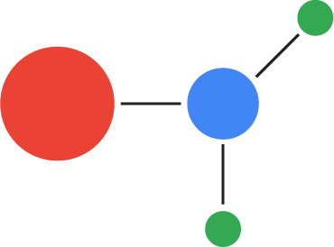

The computational thinking model
The computational thinking model is used if you are analyzing data as the test for your project.
Decomposition
Breaking larger problems into smaller, more manageable problems.
Pattern recognition
Analyze and look for patterns.
Abstraction
Filter out any unnecessary information to focus on your problem.
Algorithms
Create a solution using step-by-step instructions.
Notes:
Teacher notes
Allow students time to look at, and reflect on, the computational thinking model.
Computational thinking involves:
Taking a larger or more complex problem and breaking it down into a series of small, more manageable problems (decomposition).
Each of these smaller problems can then be looked at individually, considering how similar problems have been solved previously (pattern recognition)
It focuses only on the important details, while ignoring irrelevant information (abstraction).
Next, simple steps or rules to solve each of the smaller problems can be designed (algorithms).
Finally, these simple steps or rules are used to program a computer to help solve a complex problem in the best way.

Slide 13
The iterative design process
Define the problem
Ask a question
Do background
research
Do background
research
Define requirements
Hypothesize
Brainstorm, evaluate, and identify a solution
Experiment
Based on results, make design changes, prototype, test again, and review new results.
Review steps.
Use the results to inform a new experiment.
Develop and prototype solution
Review: is it working?
Test solution
No
Yes
Solution meets requirements
Solution meets requirements partially or not at all
Analyze data and draw conclusions
Communicate results
Results prove hypothesis
Results disprove hypothesis completely or partially
Communicate results
Notes:
Teacher notes
Explain that iterative design is used across all methods.
It helps to constantly refine until the optimum solution has been found.
Allow students time to apply these methods to aid their testing process.
Ensure students are thinking about what results they will generate and how they can use these to improve their prototype/procedure.
If students get stuck with something that is not working, encourage them to use the cube to help them past the problem.
Once students have their ‘perfect’ method, it’s time to SCAMPER.

Slide 14
Activity 2: SCAMPER
SCAMPER
Technique
Notes:
Teacher notes
This technique is used by engineers - but that doesn’t mean that you can’t apply it to all problem solving.
It prompts students to consider their design/prototype/experiment in a different way.
It acts as a checklist to refine the solution and possibly make it even better than it already is.

Slide 15
Activity 2: SCAMPER
Substitute
SCAMPER
Can any part be replaced? Can the range be changed? Can a variable be swapped with another? Could you use a different material? Could you change the shape? Can it be used in a different way?

Slide 16
Activity 2: SCAMPER
Combine
SCAMPER
Are there parts that can be combined? Can this idea merge with another? Can you include some other materials? Can you use someone else’s expertise?

Slide 17
Activity 2: SCAMPER
Adapt
SCAMPER
What else is ‘like’ this, but used for a different purpose? Where else could this be used? What does somebody who has never seen it before think it does or is used for?

Slide 18
Activity 2: SCAMPER
Modify
SCAMPER
Can it be made bigger? Can it be made smaller? Could you add something to it? Could you take something away from it? Does it have many parts and need less? Does it have few parts and need more?

Slide 19
Activity 2: SCAMPER
Purpose
SCAMPER
Why does it exist? Would it have more value used elsewhere? Is there a new need for it that hasn’t been considered? Could it be used by a different set of people to suit a different purpose?

Slide 20
Activity 2: SCAMPER
Eliminate
SCAMPER
How could it be simplified? What could be minimized? What could be eliminated? Could it be made more compact? What could be removed without changing the function?

Slide 21
Activity 2: SCAMPER
Rearrange
SCAMPER
Will it work in a different order? Consider it backwards? Could you assemble it in a different way? Would it be better/worse or no different? Or work in a completely new way?

Slide 22
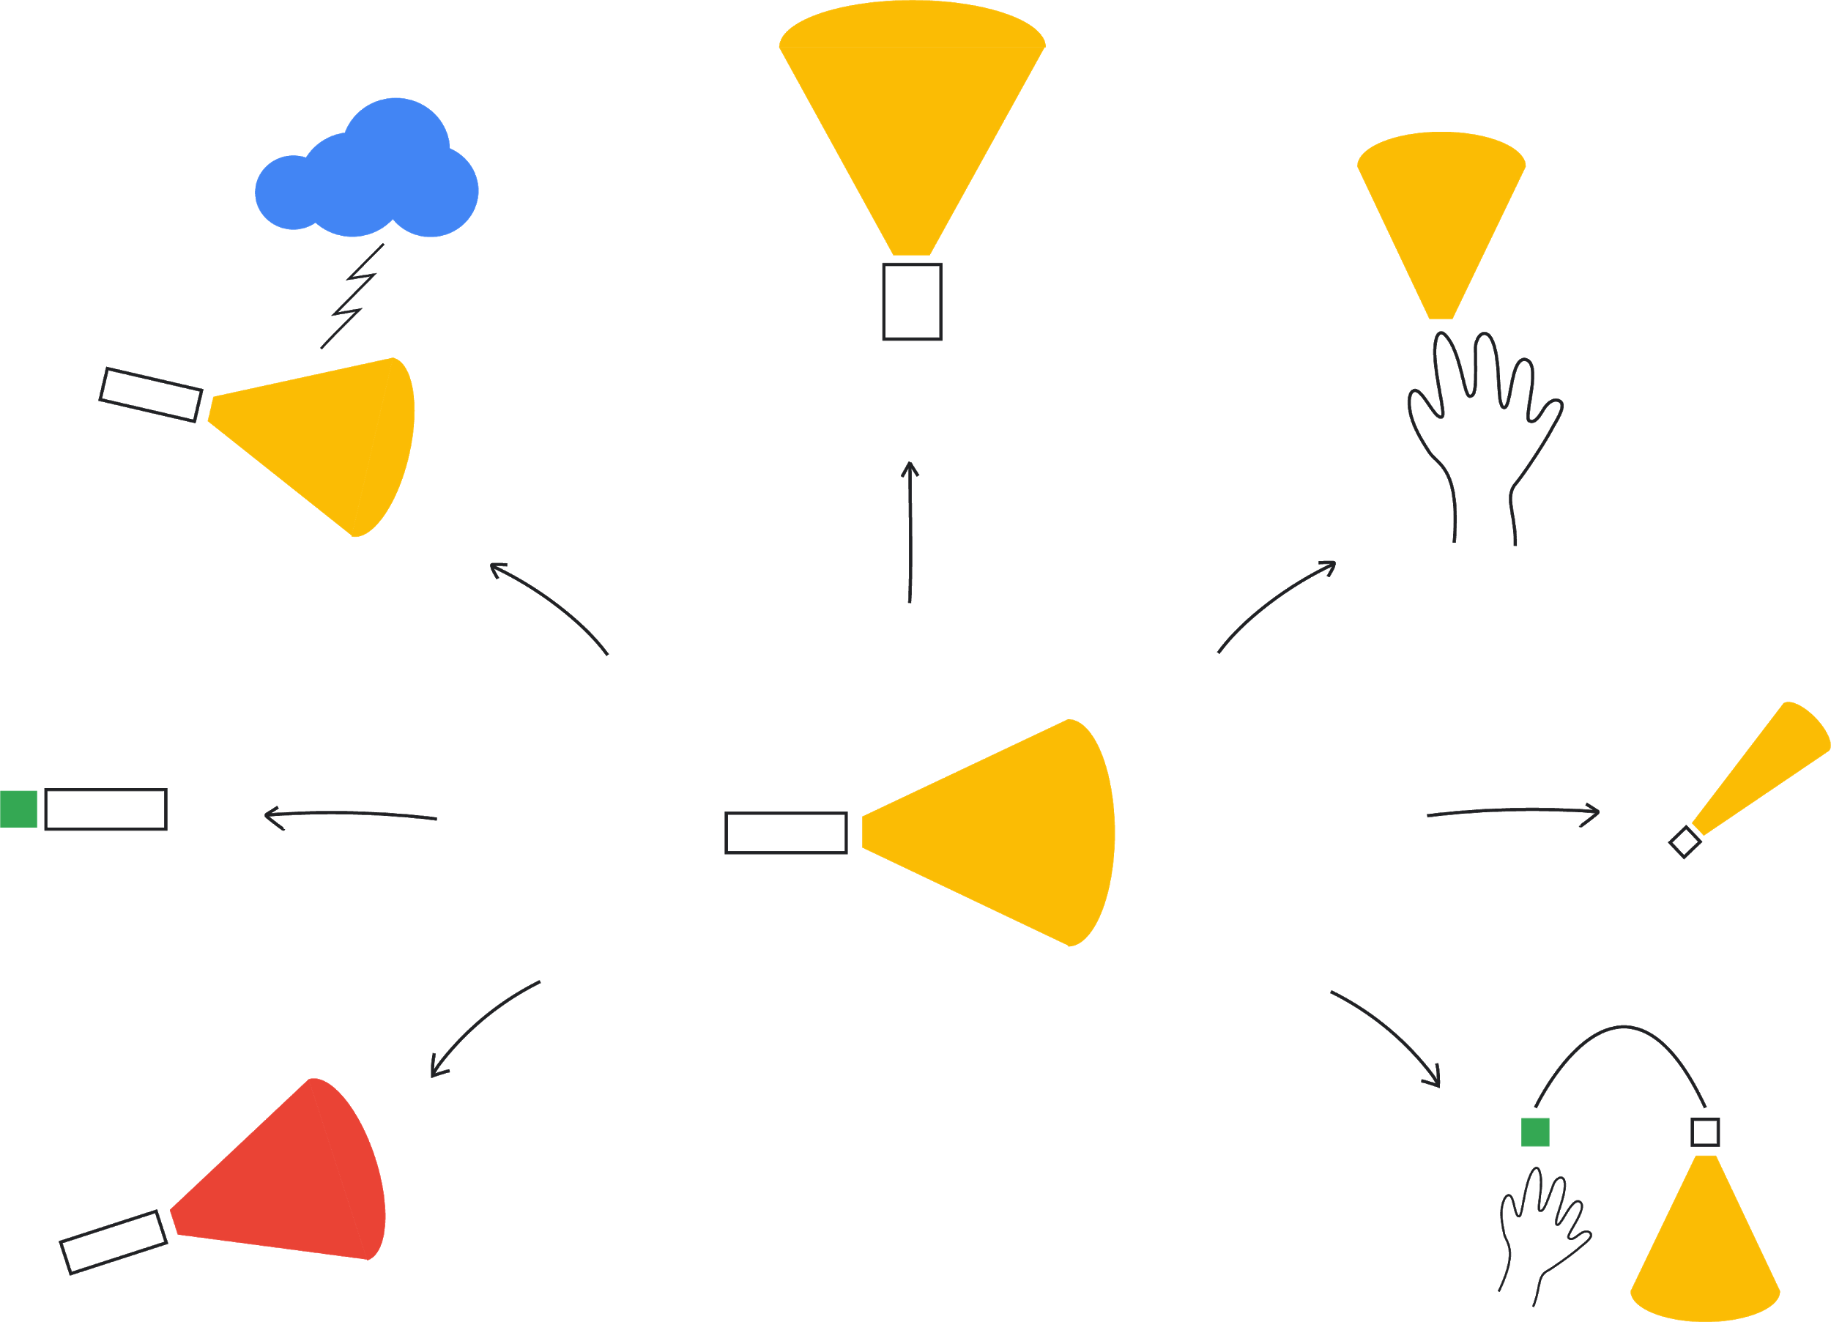
Activity 2: SCAMPER
Modify
two-hand spotlight
Adapt
disaster relief
Purpose
glove or other wearables
Combine
rechargeable battery
Eliminate
thumbprint light
Ann’s
flashlight
Substitute
change the LED color
Rearrange
external light source
Notes:
Teacher notes
Hand out Activity 2: SCAMPER.
Allow students to see how their solution could potentially be changed into something else, using Ann’s hollow flashlight as an example.
Give students time to apply SCAMPER to their solution, sharing with the class any revelations they find.
Remind students it is important that they are continually modifying and refining their idea - it may turn into something quite different, but more useful.

Slide 23

You’re ready to get results!
You’ve followed the problem-solving steps — it’s time to put all that thinking into action.
You’ll need to read the official rules and pay special attention to the health and safety procedures.
Make notes along the way. If something doesn’t work, can you go back a few steps? What were your original ideas or questions? Maybe with the knowledge you now have, one of those could work better — or maybe you have new ones?
Notes:
Teacher notes
Allow students time to continue testing independently.

Slide 24
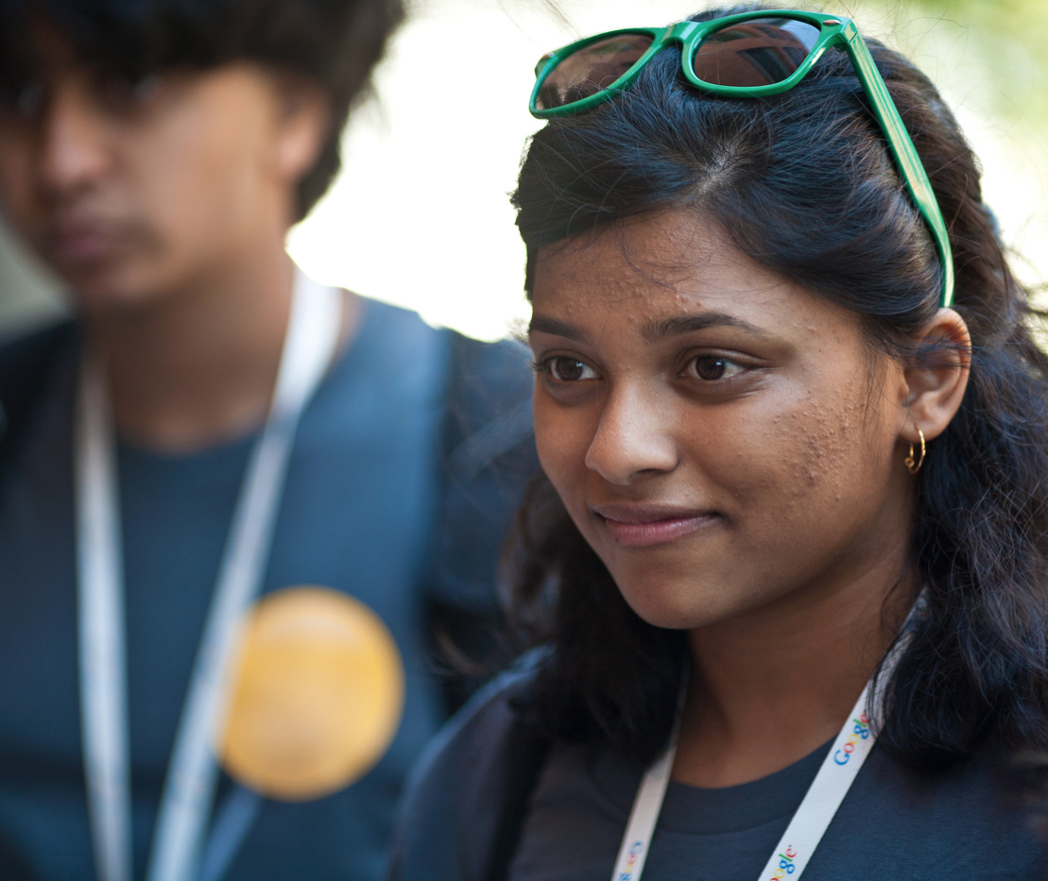
You’re ready to get results!
Keep communicating. Ask your friends, family and teachers what they think. You may even want to reach out to an expert — try writing to an expert (that’s exactly what Shree Bose did and she became the first Google Science Fair Grand Prize Winner!).
Find out more about Google Science Fair and key dates at GoogleScienceFair.com.

Slide 25
Now you have your method, it’s time to test your solution and gather results!
Session 5: Communicate the results

